Slide 1

Day 1 (MM/DD/YYYY)
D-Code

Slide 2
Welcome!

Slide 3
Today’s Goals
Meet the Instructors
Craft our team agreement
Meet the team
Discuss our goals
Discuss our workflow
What is programming?
DEV TIME!

Slide 4
The Instructors

Slide 5
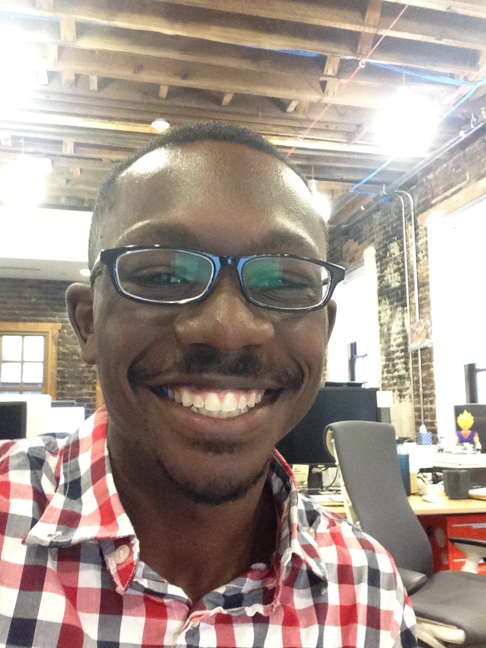
Kyle
Java/Android developer
Grew up in Ohio
Enjoy traveling and learning about different places
Graduated from Princeton
Like cereal, especially Honey Bunches of Oats
Into French hip-hop/pop at the moment

Slide 6
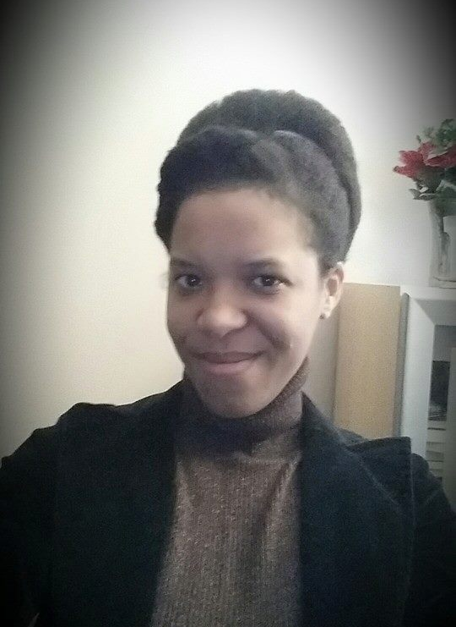
Brandy
Writer of Code (Java)
Writer of Words (Poetry)
Mom of two small humans
Detroit Born and Raised
Halo Mistress Chief (Ubisoft)
Reader of Sci-Fi
Part Android

Slide 7
Today’s Goals
Meet the Instructors
Craft our team agreement
Meet the team
Discuss our goals
Discuss our workflow
What is programming?
DEV TIME!

Slide 8
Why a team agreement?

Slide 9
Why a team agreement?
Your reasons: _________
How have computers taken over the world?
Notes:
Ask students why they think we’re putting procedures in, especially when we’re not their classroom teachers.
Motivating story: how have computers taken over the world? Because they do what they do well. Take in the input, put out the output, not wasting time. Simple, but can do really complicated things that blow people’s minds—and they just get better and better. For this to happen, all parts of the computer have to work cohesively (they make up one unit). If one part is broken, the whole thing will not work (talking about the motherboard here). Negative feelings towards others, procrastination, not wanting to work with people, outright aggression towards one another… We don’t want this class to be like that. We want you to can maximize your potential

Slide 10
It’s like a contract… but collaborative

Slide 11
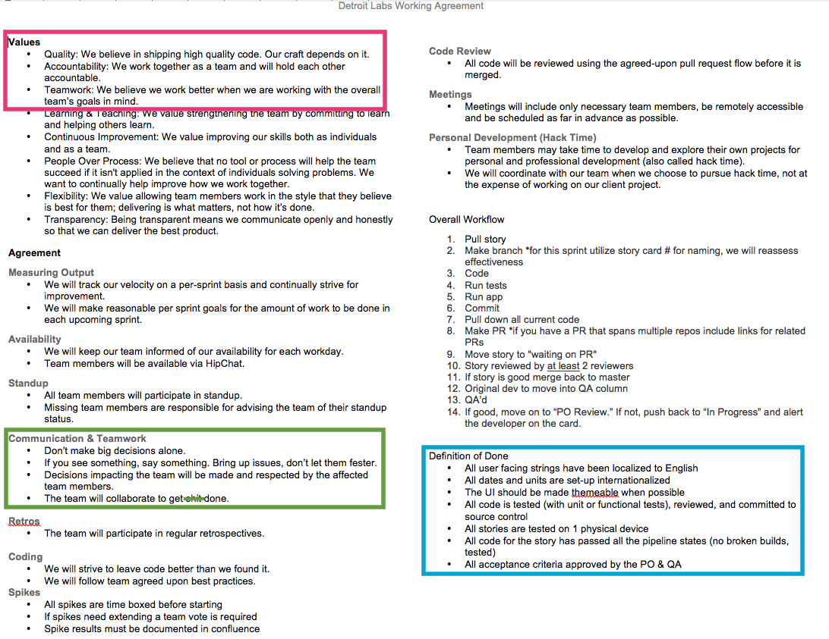
Notes:
Just want to go over bits and pieces of Brandy’s team’s working agreement at a high level (not get lost in all the detail):
Purpose is to show how we want to work as a team, from values to particular processes.
For our purposes, most important thing is values; we’ll learn the processes as we go on.

Slide 12
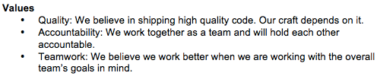
Sample Team Agreement

Slide 13
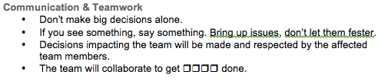
Sample Team Agreement
Notes:
An example of an important section. Others include “who should meetings involve”, “do we review each other’s code”, “how do we keep people in the loop about our availability”…

Slide 14
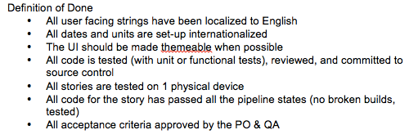
Sample Team Agreement

Slide 15
D-Code Team Agreement
Some things to keep in mind while we’re crafting our agreement:
Working Agreements are social contracts that outline how we will work as a team.
While every single team member is vital to the whole, we succeed or fail as a unit.
Give your opinions respectfully and receive other’s with equal respect.
Notes:
We will hold ourselves to standard we come up with.
Value we would like to include: Respect, Integrity and the Right Effort (not just acting for action’s sake)…
Time Commitment / Availability
We will be present each scheduled class.
We will be focused on our learning materials for that day.
If we know we will be absent we will let our team know.
Communication and Teamwork
We will communicate with respect to everyone.
We will give and receive constructive feedback.
We will get input from team members before making decisions that affect the team.
Effort
We will do our best to meet our deadlines.
If we cannot meet our deadlines, we will give our team members enough advance notice.
Coding and Code Review
We will write our best code.
We will follow Boy Scout Rules : “Leave it better than you found it”
We will be respectful and encouraging to teammates during code reviews, keeping in mind that we are all learning.
Personal Development
We will study on our own to further progress our knowledge (and bring it back to share!).

Slide 16
The Consequences
Since we all agree on this, breaking the team agreement will result in a reminder the first time. Continuing the behavior will lead to a final warning.
Because this behavior leads to a poorly-functioning team, a team member who continues past the final warning will be asked to leave the class.
Since we are a team, we want to encourage each other to keep the agreement.
Notes:
-Don’t expect that it will come to this.
-Not our job; here to teach you something new.
-Also, we’re understanding people—if having a rough day, you can talk to us, but can’t ruin things for others.

Slide 17
Questions?

Slide 18
Today’s Goals
Meet the Instructors
Craft our team agreement
Meet the team
Discuss our goals
Discuss our workflow
What is programming?
DEV TIME!

Slide 19
Meet the Team
There are two teams.
Everyone write a fact about themselves and put it in their team’s bag. Then, the teams switch bags.
The first person pulls out a fact and reads it aloud.
Then, they have one chance to guess who the fact belongs to, after deliberating with your team.
If they get it right, their team gets a point. (If they get it wrong, don’t give it away yet!)
The other team guesses next. Continue until everyone has guessed.
Notes:
Directions for participants: The first student will read the fact aloud, guess who it belongs to. Limit 2 guesses. Then owner identifies themselves and restates their name and fact. Team (Everyone) gets a point for every right fact guess. Then, pass the bag on to the next student.

Slide 20
Today’s Goals
Meet the Instructors
Craft our team agreement
Meet the team
Discuss our goals
Discuss our workflow
What is programming?
DEV TIME!

Slide 21
Why are we here?

Slide 22
Team Goals
Introduce you to the world of software development
Learn the basics of Javascript, HTML and CSS
Use what we learn to ship something cool

Slide 23
Why are you here?

Slide 24
Individual Goals
A software developer’s most important development is themselves.
Remember that there is always something new to learn and we should be willing to learn something new every chance we get.
You will never know everything…
but you can always google it.

Slide 25
Goal Map
Notes:
In this program, it’ll be clear that only you can make yourself get the knowledge you want. That should be maybe a little scary, but also empowering!
Have students record 3 goals for this class.
Have students record 3 apprehensions they have about meeting their goals.

Slide 26
Today’s Goals
Meet the Instructors
Craft our team agreement
Meet the team
Discuss our goals
Discuss our workflow
What is programming?
DEV TIME!

Slide 27
How will this work?

Slide 28
Flow of Class
Review
Teaching & Exercise
Little bit of us talking or showing you a concept
Practice that concept on your own
Come back together, share and compare methods
Individual work time

Slide 29
Today’s Goals
Meet the Instructors
Craft our team agreement
Meet the team
Discuss our goals
Discuss our workflow
What is programming?
DEV TIME!

Slide 30
break;
What is programming?
Notes:
Ask students to answer this question in their own words?

Slide 31


Slide 32
Anatomy of an EarSketch Project: What is programming?
Computer code is a collection of typed words that the computer can clearly understand. Just as a human translator might translate from the English language to Spanish, the computer interprets these words as ones and zeros. We as humans use programming languages, instead of writing directly in ones and zeros, so we can easily write and understand the computer code and can organize it.
Notes:
This is a definition we found online from Georgia Institute of Technology that we thought was pretty clear.

Slide 33
We can think of the different lines of our code as being individual instructions that we give to the computer. The computer follows these instructions explicitly to execute our written code.
http://earsketch.gatech.edu/category/learning/anatomy-of-an-earsketch-project/what-is-programming

Slide 34
continue;
We know that was a lot of information to take in but we promise that as we work together as a development team, utilizing these concepts to create viable products, and learning new and exciting concepts and tools, this first day will seem like the breeze.

Slide 35
Today’s Goals
Meet the Instructors
Craft our team agreement
Meet the team
Discuss our goals
Discuss our workflow
What is programming?
DEV TIME!

Slide 36
Developers Use Tools
Explore the Developer Tools - instructions (for Google Chrome)
Click “View”
Click “Developer”
Click “Developer Tools”
OR - Command + Option+ I

Slide 37
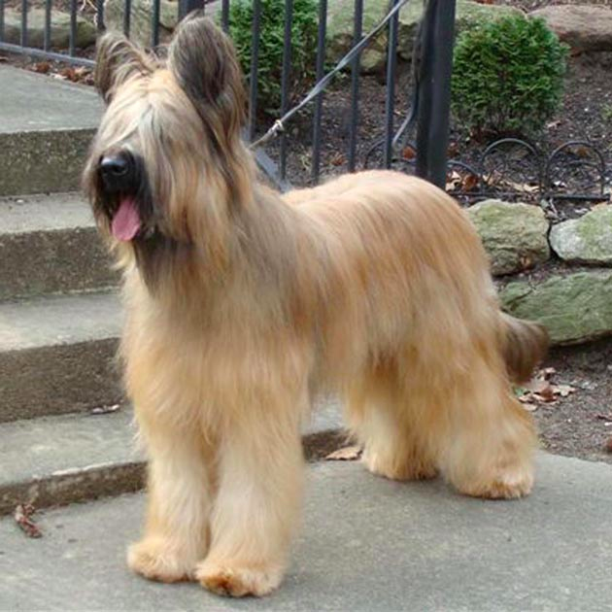
Briard Challenge

Slide 38
Briard Challenge
Type the following in your browser:
http://www.htmlandcssbook.com/code-samples/chapter-12/example.html
Open the Developer Tools, click on the tab that says “Console”
Type each line of code, then press enter:
intro = document.getElementsByClassName(“intro”);
intro[0].innerHTML(“I love briards, they are so funny”);
What happens? (Try pressing refresh.)
Notes:
This is meant to show you just how easy it is to change the appearance of a real website.
At end, reveal that we haven’t actually changed anything.

Slide 39
Udacity Challenge
Type the following in your browser:
http://udacity.github.io/js-basics/static-home/index.html
Open the Developer Tools, click on the tab that says “Console”
Type the following code exactly the way it is here, then press enter: $(".super-header-wrapper").html("<img style='width:100%' src='http://goo.gl/WCrBmS'>");
What happens?
Notes:
The format is complicated, but we’ll start to learn more as time goes on.

Slide 40
finally{
talkAboutWhatWe’veLearned();
}
Notes:
Get answers from around the classroom:
1. Something that you learned today.
2. After today, how are you feeling?

Slide 41
Today’s Goals
Meet the Teachers & Procedures
Meet the Team
Discuss our goals
Discuss our workflow
Craft our team agreement
DEV TIME!
And now we’re done!
At least… by our definition of done.

